Slide 1
Public Entrepreneurship as a Governance Mindset to Poverty Alleviation in Zimbabwe.
By
Dr. Nicholas Kakava & Mr. Misheck Gubhi
Chinhoyi University of Technology
Zimbabwe School of Entrepreneurship & Business Sciences nzkakava@gmail.com
+263712316741 +263772887043

Slide 2
Background of the study
Zimbabwe is one of the African countries which may still have the majority of the families living at less than the international poverty line of US$1.90 a day and this situation could be currently worse than ever.
As citizens are faced with economic and political challenges, they tend to go informal (Sithole & Muguti, 2018). Social systems under such situations tend to create survival strategies so as to earn a living. When societies seek to engage in economic activities which are aimed at survival, it also means they would be poor.
According to Rogerson (2018) “informality is a distinguishing trait of economic life across much of the global South”. The informal sector has merit to societies because of various reasons which include: versatility, avoiding government procedures and regulations and subverting the tax regime.
On the other hand, when society goes informal, some governments may view such behaviour as indiscipline, yet it supposed to be viewed as entrepreneurial (Bango et al., 2018). As such governments would react in a way that would show that they are in control.

Slide 3
Background of the study Cont…
The government may also react by introducing some measures like introducing presumptive taxes to the informal sector (Dube & Casale, 2019). Thus when a government views and reacts to social economic activities this way, it is viewed in this study as contributing to poverty, and this becomes a governance and policing problem.
According to Ostrom (2005), opening the public sphere to entrepreneurship and innovation at local, regional, and international levels is also a key to increasing the level and quality of public goods – e.g., peace, safety, and health – available to citizens.
In other words, when governments have a specific focus on entrepreneurship within their law enforcement agencies and the institution of policing, they enhance the wellbeing of their citizens.
Innovation can occur in the provision of law enforcement activities that emanate from an entrepreneurial mindset which unlocks individual freedom as the public sector is also unlocked from rigid, top-down, hierarchical organization (Ostrom, 2005).

Slide 4
OBJECTIVES
The aim of the study was to establish the ideal government mind-set towards the informal sector and how it will contribute towards alleviation of poverty.
The objectives of the study were:
To establish reasons of getting into informal dealings.
To examine government’s reaction to informal dealings
To establish the government argument of eradicating the informal dealings
To analyse people’s expectations from the government

Slide 5
METHODS
The researcher used 3 consecutive group interviews to gather qualitative data from venders and money changers in Chinhoyi town. Each group interview had 10 people which consisted of vendors and money changers.

Slide 6
FINDINGS
The findings from the 3 group interviews were tabulated and summarised in four categories: reasons of going informal, government reactions to informal dealings, the government rationale of reaction and the people’s expectations from their governments. The commonly stated results from the interviewees were presented in Table 1 below.
An analysis of the results in Table 1 shows that there is a rift between the mind-set of the government and that of the people. Generally people aim to enhance their wellbeing and their waste enemy is poverty which puts the wellbeing of the people at stake. The people, in the effort to fight poverty then get into some informal economic activities. As such, the people have expectations from the government which mostly has to do with governance - policing and law enforcement which enhance the people’s wellbeing. In contrast, the government in most instances view the people’s efforts as looking down upon the government as an authority (Mukorera, 2019). The reaction of the government to the people’s survival efforts is evidence of poor governance which lead to perpetuation of poverty in Zimbabwe and other developing African countries.
Table 1: Qualitative Data from the Group Interviews.

Slide 7
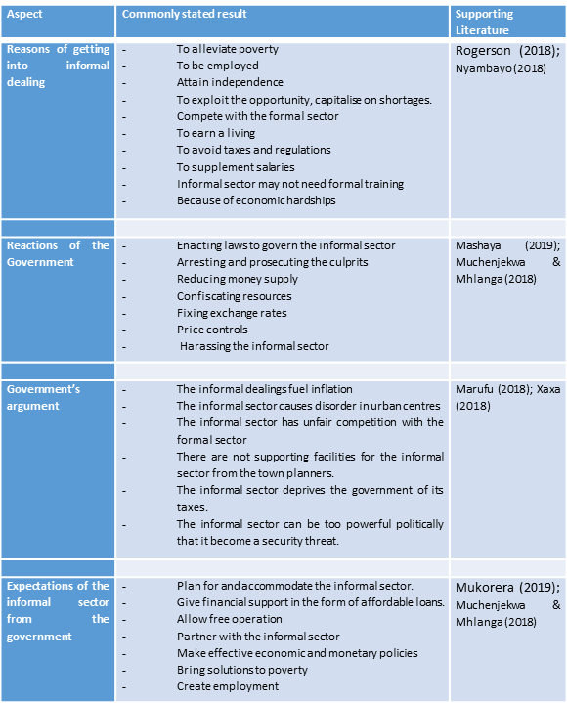

Slide 8
ARGUMENT
There is need of a common ground and harmonized view of the economic, political and social systems, between the governments and its society in developing nations so as to reduce poverty and attain some economic prosperity.
A public entrepreneurial mindset can harmonise the views of the government and its societies.
In light of Mukorera (2019) conclusions that willingness/unwillingness of the informal entrepreneurs in Zimbabwe to formalize is related to governance, means that harmonization of interests can be attained. Thus this can be best met by both parties, the government and the society should have an entrepreneurial mind-set.

Slide 9
CONCLUSION
The reactions and arguments of the government to social survival initiatives is contributing to a greater extend to poverty in developing nations like Zimbabwe.
Governance issues in the nation are prohibitive, irrational and to some extend oppressive, there by suppressing economic activity which leaves the society poor.
Public entrepreneurial mindset can tap from social innovative initiatives amd can enhance the quality of policing and law enforcement there by reducing poverty in developing nations.

Slide 10
SUGGESTIONS
There is need for a paradigm shift in political leaders. Dialogue between the society and the government may assist to harmonise the society and government views.
The embracing of public entrepreneurial mindset by the government would alleviate poverty in the developing nations.
Further research could look into the motive behind the government reactions to the informal sector and the sincerity behind the government arguments.

Slide 11
References
Ostrom, E. (2005). Unlocking public entrepreneurship and public economies (No. 2005/01). Wider Discussion Papers//World Institute for Development Economics (Unu-Wider).
Bango, S. P., Ndiweni, E., Galloway, L., & Verhoeven, H. (2018). Survivalism, collectivism and proud heritage: A study of informal arts and crafts entrepreneurship in rural Zimbabwe. South African Journal of Business Management, 49(1), 1-8.
Dube, G., & Casale, D., (2019). Informal sector taxes and equity: Evidence from presumptive taxation in Zimbabwe. Development Policy Review, 37(1), 47-66.
Hayter, C. S., Link, A. N., & Scott, J. T. (2018). Public-sector entrepreneurship. Oxford Review of Economic Policy, 34(4), 676-694.
Lucas, D. S., (2018). Evidence-based policy as public entrepreneurship. Public Management Review, 20(11), 1602-1622.
Marufu, L., (2018). Money changers face prosecution The Herald www.herald.co.zw 8 May, 2018
Mashaya, B., (2019). Government losing war on money changers Daily News www.dailynews.co.zw/articles 11 February 2019.
Muchenjekwa, K., & Mhlanga B. (2018). Cops, Vendors Clash www.newsday.co.zw 21 September 2018
Mukorera, S. Z., (2019). Willingness To Formalize: A Case Study Of The Informal Micro And Small-Scale Enterprises In Zimbabwe. Journal of Developmental Entrepreneurship, 24(01), 1950001.
Nyambayo, L., (2018) Govt, Vendors clash Daily News www.dailynews.co.zw/articles 15 September 2018
Rogerson, C. M., (2018). Informal sector city tourism: cross-border shoppers in Johannesburg. GeoJournal of Tourism & Geosites, 22(2).
Sithole, A., & Muguti, T., (2018). More than Three Decades of Deprivation and Impoverishment: The growth of the informal Sector during the Mugabe Era in Zimbabwe. The End of an Era? Robert Mugabe and a Conflicting Legacy, 271.
Xaxa, (2018). Police Arrest 170 Money Changers Nationwide Pindula News /news.pindula.co.zw 25 October 2018.

